Slide 1
Mobile Application Development
Intents

Slide 2
Intents
An Intent is a message that describes a desired action, data to be acted upon, and the category of component that should perform the action
An intent is used as a message for starting or activating 3 main components of an application .
These include 1. Activities, 2. Services, and 3. Broadcast receivers
An intent can be received by 0 or more components.

Slide 3
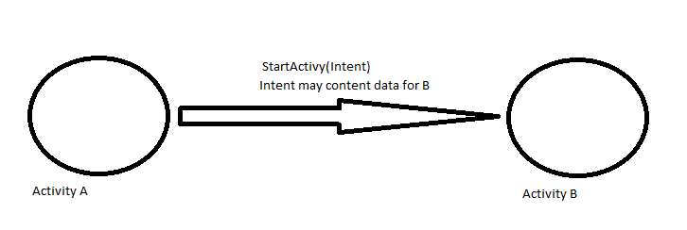
Types of Intents
1 . Directed intent:
Has one specific recipient.
For example , an Activity A can use an intent to start another
Activity B.

Slide 4
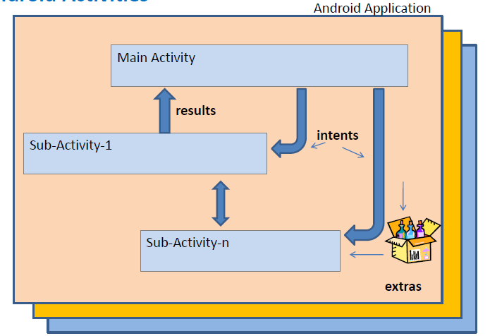
Types of Intents.
2. Broadcast intent: The message can be received by anyone.
It is Broadcasted by one component

Slide 5
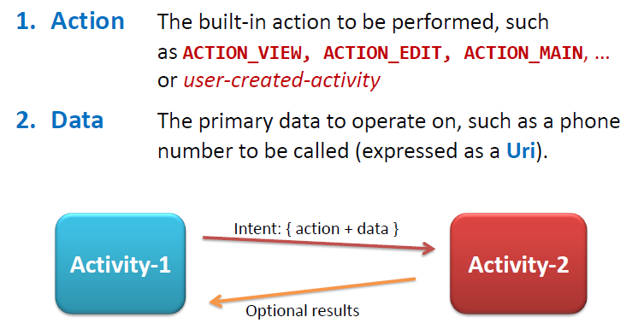
Primary Attributes of an Intent
An Intent has two primary attributes:

Slide 6
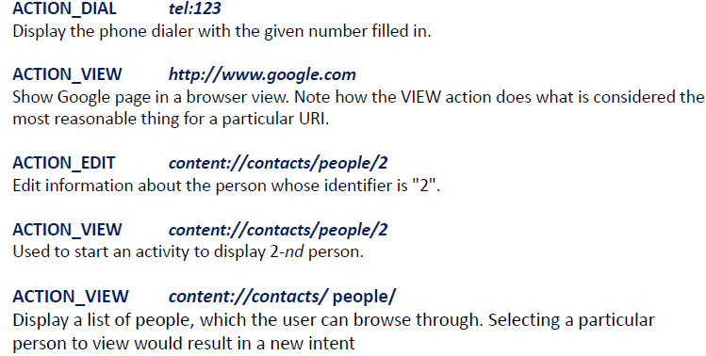
Examples of Intents
Examples Intents(i.e Action/data pairs):

Slide 7
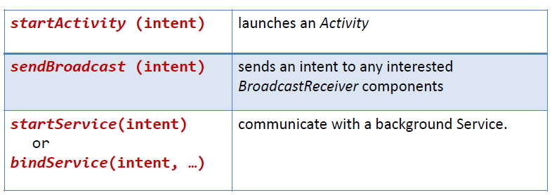
Declaring and Invoking Intents: Example
Intents are invoked using the following methods

Slide 8
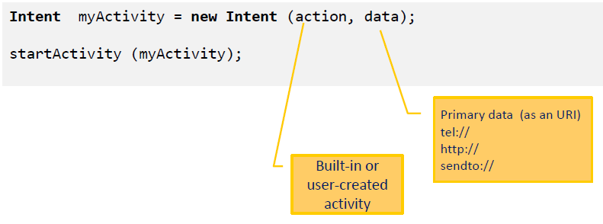
Declaring and Invoking Intents: syntax

Slide 9
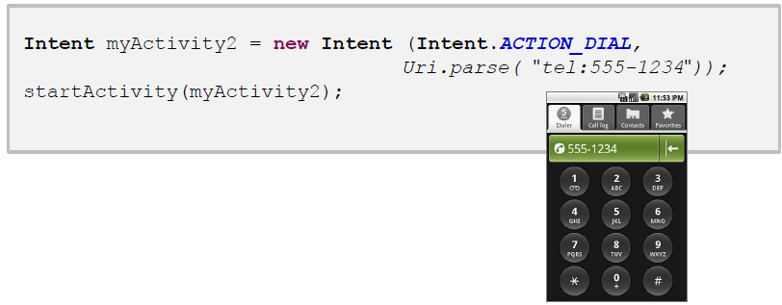
Declaring and Invoking Intents: Example
The following code displays the phone dialler with a given number filled in

Slide 10
Using Intents to launch activities
An intent can be used to launch other activities using StartActivity () method
Format:
Intent intent_object = new Intent (this activity, activity two);
startActivity(intent_object);
Example:
The following code create an intent object for launching Home.class activity
Intent intent = new Intent (this, Home.class);
startActivity(intent);

Slide 11
Secondary Attributes of An Intent
In addition to the primary action/data attributes, there are a number of secondary attributes that you can also include with an intent, such as:
1. Category
2. Components
3. Type
4. Extras

Slide 12
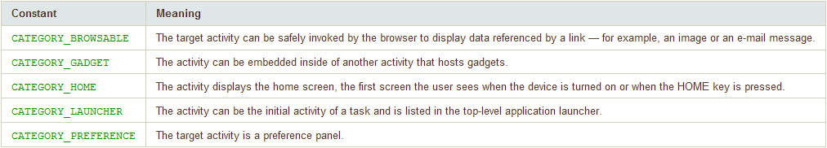
Secondary Attributes of An Intent
1. Category: Describes additional information about
The components that handle the intent.
Examples:

Slide 13
Secondary Attributes of An Intent
2. Type: describes the type of the Intent data.
If Type is not specified, Android will infer the type
Format:
Intent.setType(String type)
Intent.setDataAndType(Uri data, String type)

Slide 14

Secondary Attributes of An Intent
3. Component: describes the component to receive the intent

Slide 15
Secondary Attributes of An Intent
4. Extra : describes additional information associated with the intent.
It is treated as a map (key-value pairs)
Format for setting extras:
Example:
  i. putExtra(“key1”, “Some data”);
  i. putExtra(“key2”, “more data”);
Intent intent = new Intent (this, HelloWorld.class);
intent.putExtra(“title”,”Hello codeandroid”);
startActivity(intent);

Slide 16
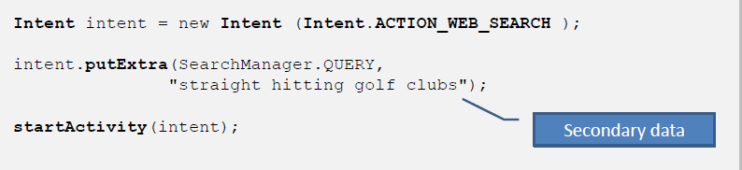

Intents -Secondary Attributes
4. Extra
Example : performing a Google search looking for golf clubs
Results

Slide 17
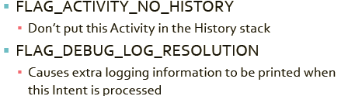

Secondary Attributes of An Intent
5. Flag: describes how Intent should be handled
Examples:
The following statements specifies that the intent known as newint should not be put in the history stack

Slide 18
Intent Filters
Intent filter is used to declare a list of intents an activity/service is interested in.
Intent filters are used to filter out unwanted intents so that users are informed by specific intents only .
They are used to inform the system which implicit intents can handle, activities, services, and broadcast receivers.
Each filter describes a capability of the component and a set of intents that the component is willing to receive.

Slide 19
Intent Filters
Intent filter declares intents in the AndroidManifest file.
<?xml version="1.0" encoding="utf-8"?>
<manifest . . . >
<application . . . >
<activity android:name="com.example.project.FreneticActivity"
android:icon="@drawable/small_pic.png"
android:label="@string/freneticLabel"
. . . >
<intent-filter . . . >
<action android:name="android.intent.action.MAIN" />
<category android:name="android.intent.category.LAUNCHER" />
</intent-filter>
<intent-filter . . . >
<action android:name="com.example.project.BOUNCE" />
<data android:mimeType="image/jpeg" />
<category android:name="android.intent.category.DEFAULT" />
</intent-filter>
</activity>
. . .
</application>
</manifest>
Launch Main Activity
Show the app in the Launcher
Activity
Handles JPEG images in Certain way

Slide 20
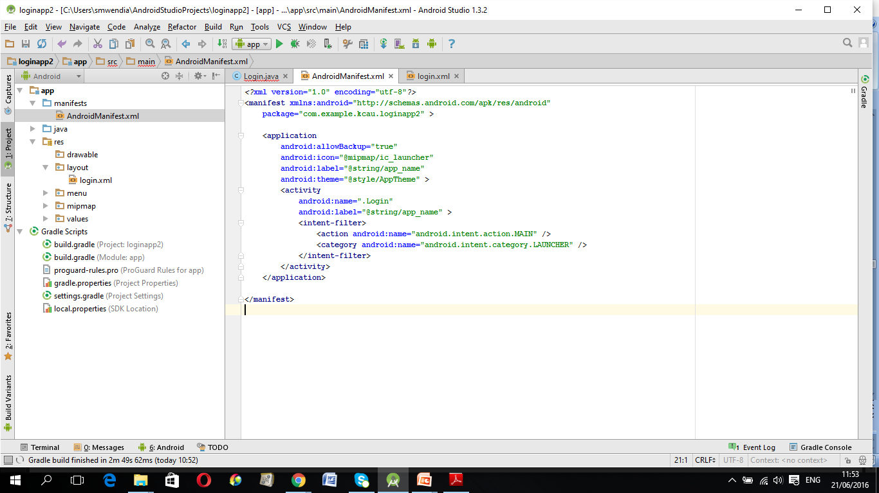
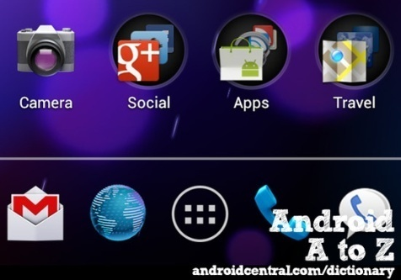
Intent Filters
The xml code in the previous slide, the following
<intent-filter> label in AndroidManifest.xml file specifies the Intent that can start the Activity.
In this example the intent filter declares that the Main activity, will be started automatically when the app starts.
The following line means that the application should appear in the Launcher as a top-level application
The launcher is the home screen where applications can be started by the user.

Slide 21
Intent Filter
For example, if application wants to display a web page, it expresses its "Intent" to view the URL by creating an Intent instance and handing it off to the system.
The system locates the Browser that knows how to handle that Intent, and runs it; or to broadcast interesting events (such as a notification) system-wide.
For Example the <intent-filter> label in AndroidManifest.xml file specifies the Intent that can start the Activity
i.e
In this example the intent filter declares that the Main activity, will be started automatically when the app starts

Slide 22





